Slide 1
Module 2 – Confidence Intervals

Slide 2
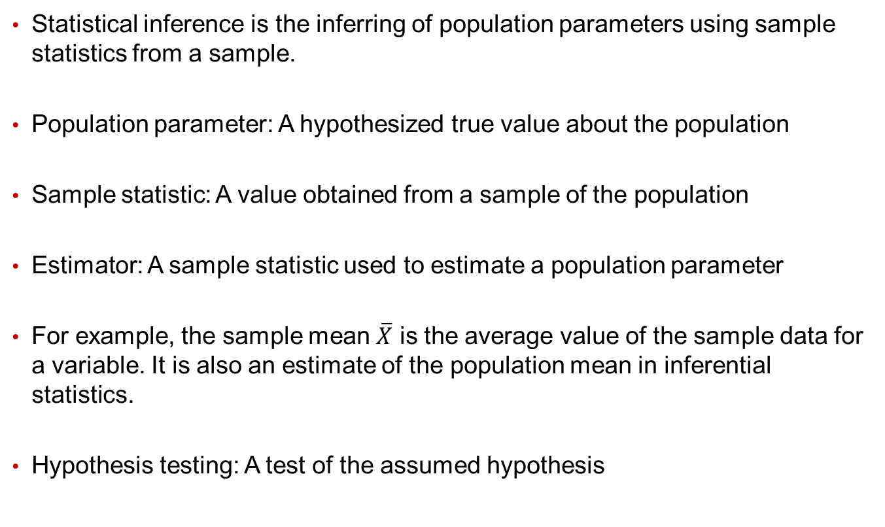
Statistical Inference
Statistical inference is the inferring of population parameters using sample statistics from a sample.
Population parameter: A hypothesized true value about the population
Sample statistic: A value obtained from a sample of the population
Estimator: A sample statistic used to estimate a population parameter
For example, the sample mean $\overline{X}$ is the average value of the sample data for a variable. It is also an estimate of the population mean in inferential statistics.
Hypothesis testing: A test of the assumed hypothesis

Slide 3
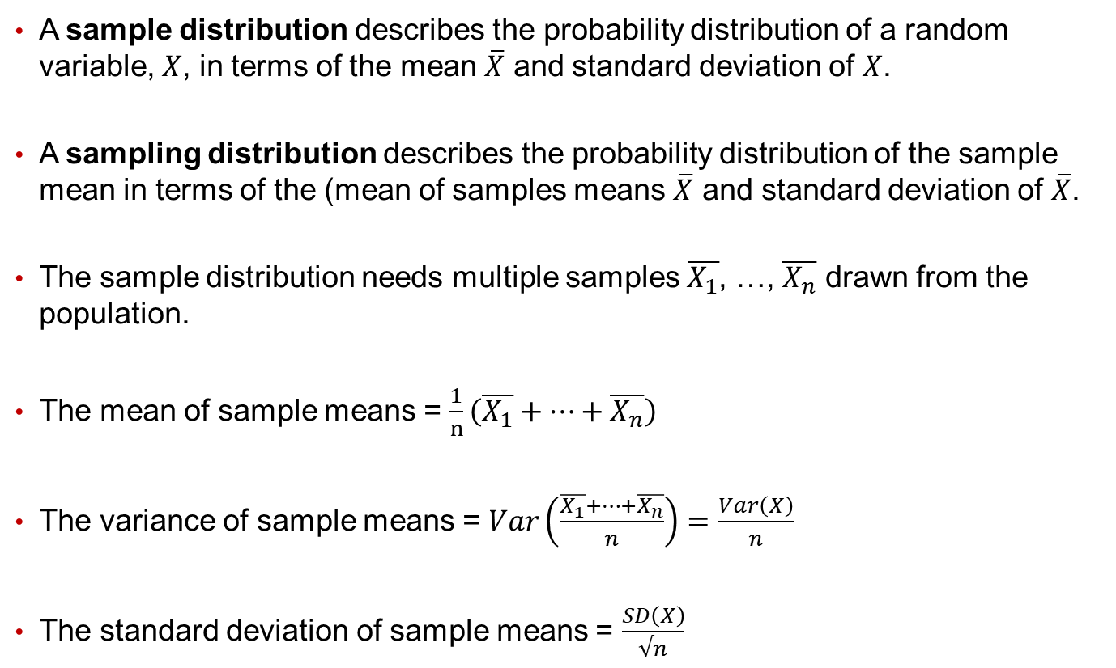
Sample Distributions vs. Sampling Distribution
A sample distribution describes the probability distribution of a random variable, $X$, in terms of the mean $\overline{X}$ and standard deviation of $X$.
A sampling distribution describes the probability distribution of the sample mean in terms of the (mean of samples means $\overline{X}$ and standard deviation of $\overline{X}$.
The sample distribution needs multiple samples $\overline{X_{1}}$, …, $\overline{X_{n}}$ drawn from the population.
The mean of sample means = $\frac{1}{n}\left(\overline{X_{1}}+…+\overline{X_{n}}\right)$
The variance of sample means = $Var\left(\frac{\overline{X_{1}}+…+\overline{X_{n}}}{n}\right)=\frac{Var\left(X\right)}{n}$
The standard deviation of sample means = $\frac{SD\left(X\right)}{√n}$

Slide 4
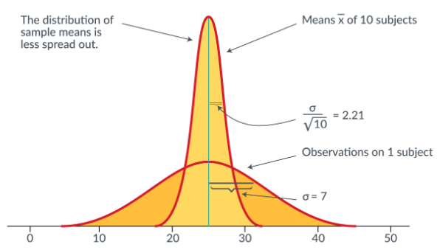

Sample Distributions vs. Sampling Distribution
The graph below compares the distributions of $X$ and $\overline{X}$.
The distribution of random variable $X$is not always normal.
The distribution of random variable $\overline{X}$ approaches normal when $n>30$ based on the Central Limit Theorem.

Slide 5
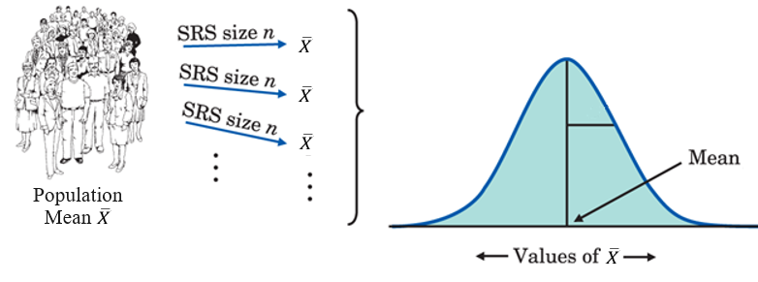
Central Limit Theorem
The process above illustrates the central limit theorem, which says that as we take more and more simple random samples (SRS) from a population, the distribution of the mean of these observations eventually gets close to a normal distribution.
The central limit theorem lies behind the use of normal sampling distributions for sample means.

Slide 6
Law of Averages (Law of Large Numbers)
The law of large numbers states that in a large number of “independent” repetitions of a random phenomenon (such as coin tossing), averages or proportions are likely to become more stable as the number of trials increases, whereas sums or counts are likely to become more variable.
i.e. As the number of identically distributed, randomly generated variables increases, their sample mean approaches their theoretical mean.
e.g. We saw that the proportion of heads gradually becomes closer and closer to 0.5 as the number of tosses increases.

Slide 7
Case: Casinos
The law of large numbers explains why gambling, which is a recreation or an addiction for individuals, is a business for a casino.
The “house” in a gambling operation is not gambling at all. The average winnings of a large number of customers will be quite close to the expected value.
The house has calculated the expected value ahead of time and knows what its take will be in the long run.

Slide 8
Case: Casinos
Serious gamblers often follow a system of betting in which the amount bet on each play depends on the outcome of previous plays.
You might, for example, double your bet on each spin of the roulette wheel until you win – or, of course, until your fortune is exhausted.
Such a system tries to take advantage of the fact that you have a memory even though the roulette wheel does not.
Can you beat the odds with a system? No.
Mathematicians have shown that if you do not have an infinite fortune to gamble with, your average winnings (the expected value) remain the same, and you will eventually go broke if you keep increasing your bets.

Slide 9
Case: Insurance Companies
Life insurance companies operate much like casinos: they bet that the people who buy insurance will not die.
Some do die, of course, but the insurance company knows the probabilities and relies on the law of large numbers to predict the average amount it will have to pay out.
Then the company sets its premiums high enough to guarantee a profit.

Slide 10
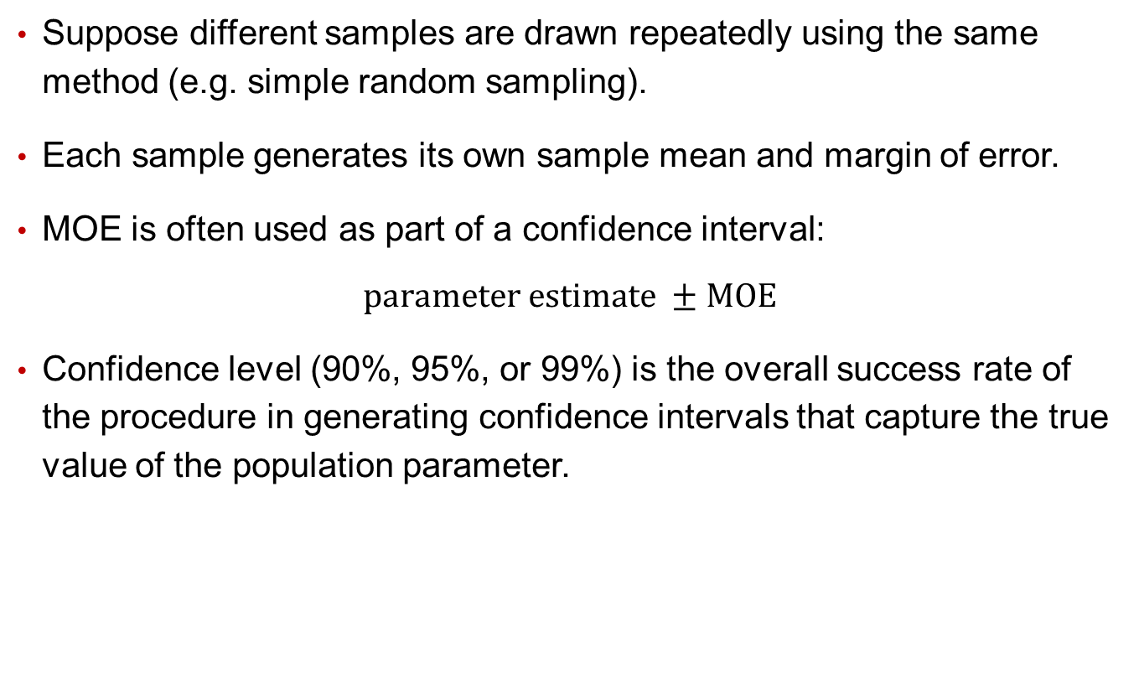
Confidence Interval
Suppose different samples are drawn repeatedly using the same method (e.g. simple random sampling).
Each sample generates its own sample mean and margin of error.
MOE is often used as part of a confidence interval:
$$parameter estimate ±MOE$$
Confidence level (90%, 95%, or 99%) is the overall success rate of the procedure in generating confidence intervals that capture the true value of the population parameter.

Slide 11
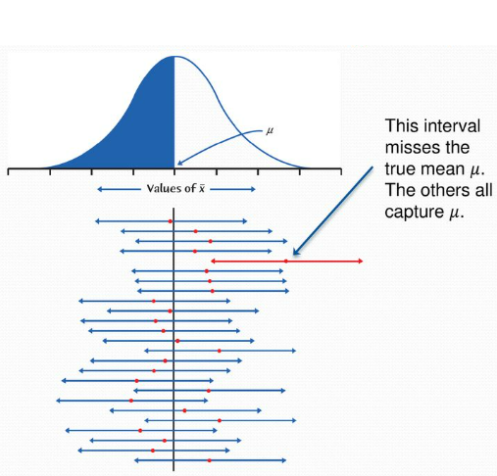
Confidence Interval
Suppose we draw 20 samples -> then we have 20 sample means, 20 MOE’s, and 20 CI’s.
If we use 95% confidence level, then 19 of the 20 CI’s would include the true mean.

Slide 12
Confidence Interval
If draw another sample, we should be quite (95%) confident that this new CI also includes the true mean.
i.e. Any confidence interval we get from a new sample should be quite reliable for describing the population and practical applications.

Slide 13
Case Study: Smartphone Usage
A survey finds that 52% plus or minus 1% of American smartphone owners check their devices several times an hour or more frequently.
The confidence interval is then 52% ± 1%, so 51% < p < 53%.
Confidence statement (about the population):
We are 95% confident that the percent of all American smartphone owners who check their devices several times an hour or more frequently is between 51% and 53%.
-OR-
We are 95% confident that between 51% and 53% of all American smartphone owners check their devices several times an hour or more frequently.

Slide 14
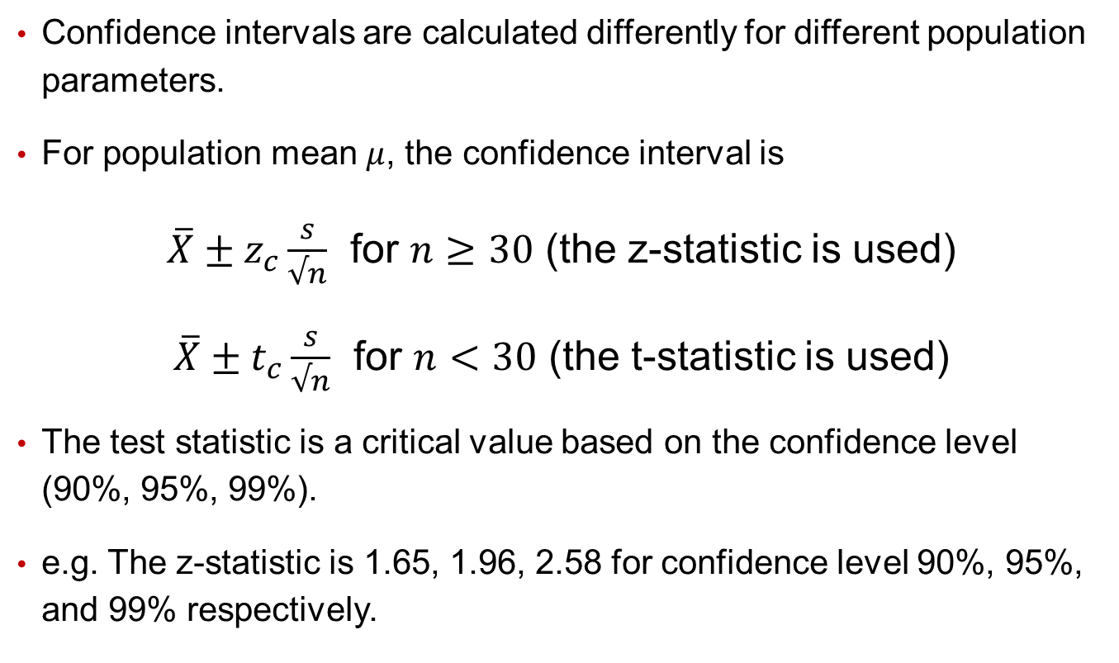
Confidence Interval for Population Mean
Confidence intervals are calculated differently for different population parameters.
For population mean $μ$, the confidence interval is
$\overline{X}±z_{c}\frac{s}{√n}$ for $n≥30$ (the z-statistic is used)
$\overline{X}±t_{c}\frac{s}{√n}$ for $n<30$ (the t-statistic is used)
The test statistic is a critical value based on the confidence level (90%, 95%, 99%).
e.g. The z-statistic is 1.65, 1.96, 2.58 for confidence level 90%, 95%, and 99% respectively.

Slide 15
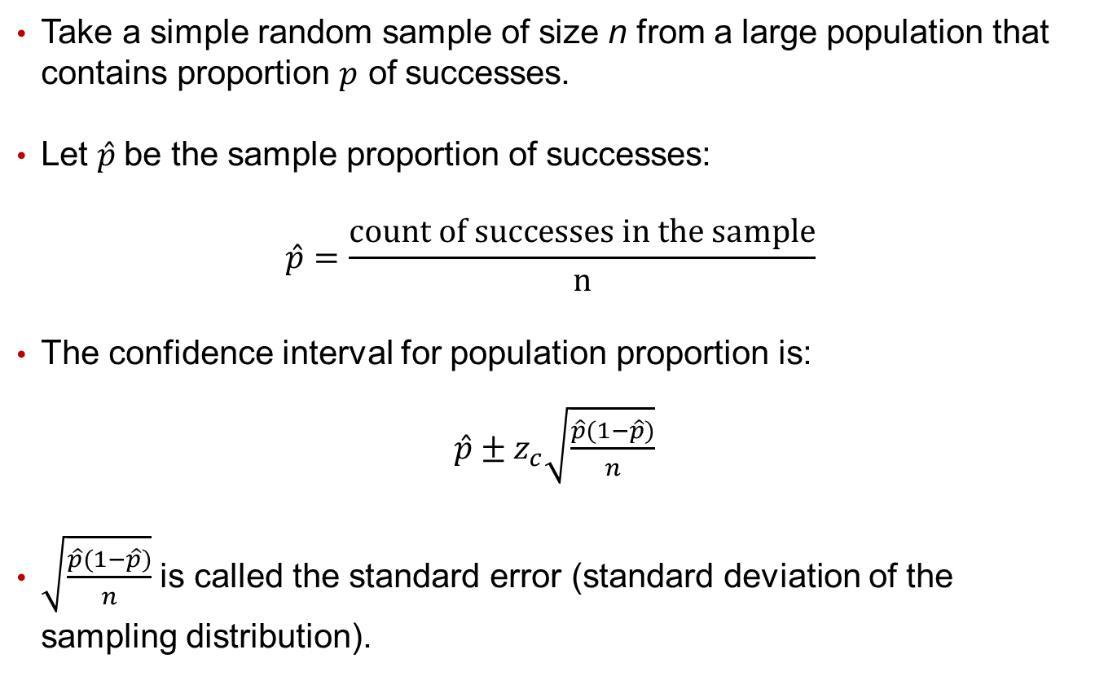
Confidence Interval for Population Proportion
Take a simple random sample of size n from a large population that contains proportion $p$ of successes.
Let $\hat{p}$be the sample proportion of successes:
$$\hat{p}=\frac{count of successes in the sample}{n}$$
The confidence interval for population proportion is:
$\hat{p}±z_{c}\sqrt{\frac{\hat{p}(1−\hat{p})}{n}}$
$\sqrt{\frac{\hat{p}(1−\hat{p})}{n}}$ is called the standard error (standard deviation of the sampling distribution).

Slide 16
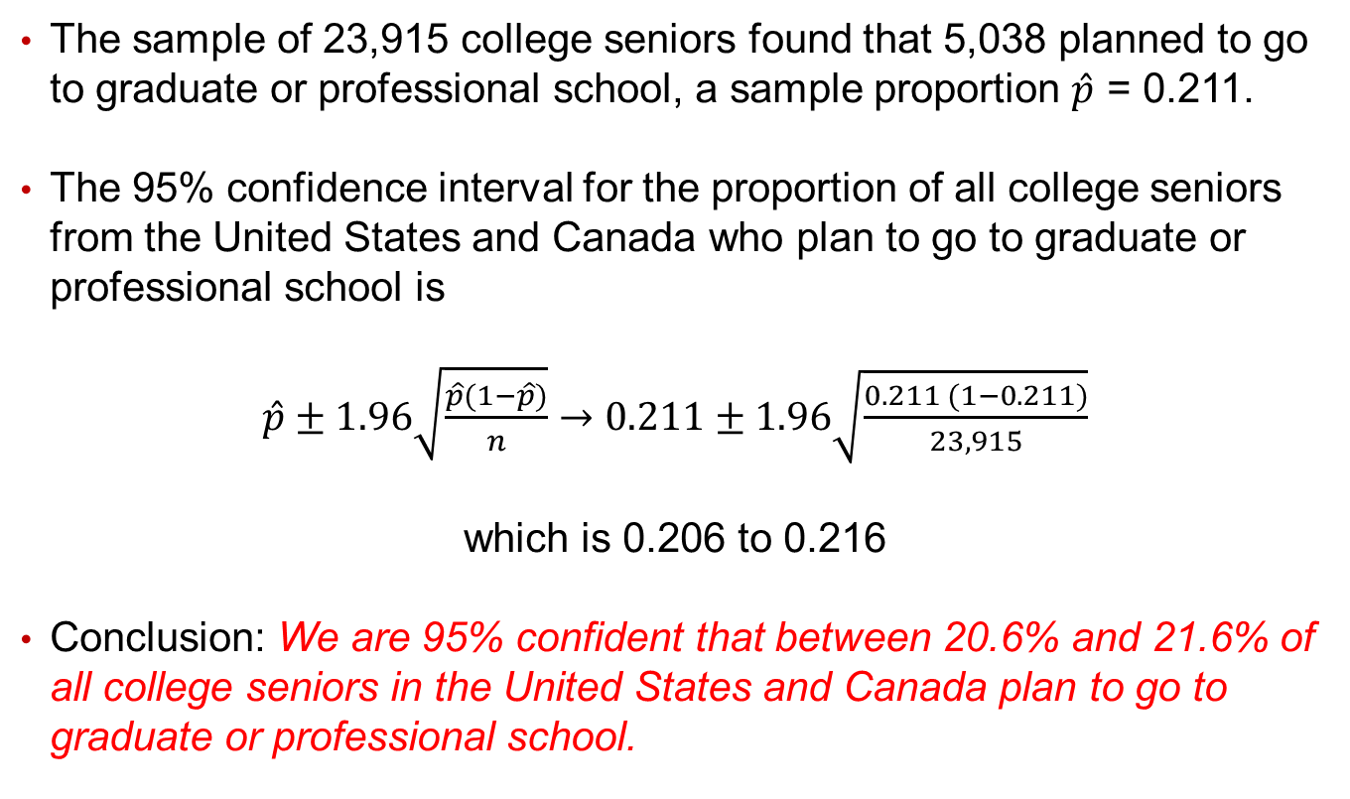
Case: Graduation Plans
The sample of 23,915 college seniors found that 5,038 planned to go to graduate or professional school, a sample proportion $\hat{p}$ = 0.211.
The 95% confidence interval for the proportion of all college seniors from the United States and Canada who plan to go to graduate or professional school is
$\hat{p}±1.96\sqrt{\frac{\hat{p}(1−\hat{p})}{n}}→0.211±1.96\sqrt{\frac{0.211 (1−0.211)}{23,915}}$
which is 0.206 to 0.216
Conclusion: We are 95% confident that between 20.6% and 21.6% of all college seniors in the United States and Canada plan to go to graduate or professional school.

Slide 17
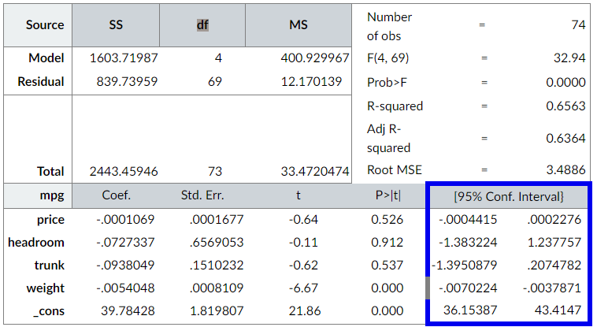
Confidence Intervals for Linear Regression Coefficients
Confidence intervals are also given for each coefficient in a linear regression. Each coefficient is an estimate of the population parameter, and the confidence interval is a measure of the error.

